Slide 1
Threading in Java
Notes:
Presentation is based on oracle threading tutorial here https://docs.oracle.com/javase/tutorial/essential/concurrency/procthread.html

Slide 2
Introduction
Motivation for concurrency
Package: java.util.concurrent
The Multis
Multiprogramming
Multiprocessing
Multithreading
Notes:
We need concurrency to speed up the computations on the machine, which means less waiting time
Multiprogramming: The ability of running multiple processes on the OS, by loading all of them in the memory while there’s enough space. If one CPU is used, then each process takes a turn to run and this turn is confined by a timing constraint (from a software pov)
Multiprocessing: The ability of running multiple programs on the OS on multiple CPUs by assigning each process on a CPU
Multithreading: The ability to divide the process execution into threads (multiple code segments) that run concurrently and share the same resources (e.g. memory)

Slide 3
Processes and Threads
Process (program)
Private resources
To communicate between processes, InterProcess Communication (IPC) is used^{(*)}
JVM running a java application is a single process
Has at least 1 thread (main thread)
A feature of the OS
Thread (lightweight process)
Shared resources (memory and open files)
A feature of the Java platform
^{(*)} Will learn about this in an OS course
Notes:
Processes
A process has a self-contained execution environment. A process generally has a complete, private set of basic run-time resources; in particular, each process has its own memory space. Processes are often seen as synonymous with programs or applications.
Most implementations of the Java virtual machine run as a single proces. A Java application can create additional processes using a ProcessBuilder object.
Threads
Both processes and threads provide an execution environment, but creating a new thread requires fewer resources than creating a new process.
Multithreaded execution is an essential feature of the Java platform. Every application has at least one thread — or several, if you count "system" threads that do things like memory management and signal handling. But from the application programmer's point of view, you start with just one thread, called the main thread. This thread has the ability to create additional threads,

Slide 4
Thread objects (Creation)
Each thread is an object of class Thread
To create a thread, you need:
A thread object (or one of its subclasses)
Implement the core of the thread (implement/override the run() method)
Call start() on the thread object which invokes the run
Define and start thread:
Implement the Runnable interface, and provide a runnable object (example_1.java)
Extend a Thread class (example_2.java)
Notes:
Thread.sleep causes the current thread to suspend execution for a specified period

Slide 5
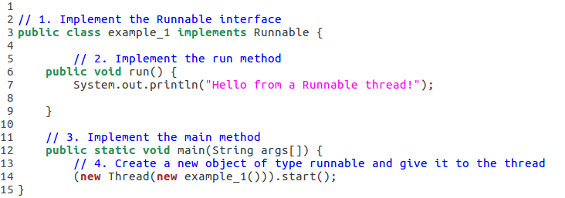
Thread objects (Creation)
Implement the Runnable interface, and provide a runnable object
Notes:
Thread.sleep causes the current thread to suspend execution for a specified period

Slide 6
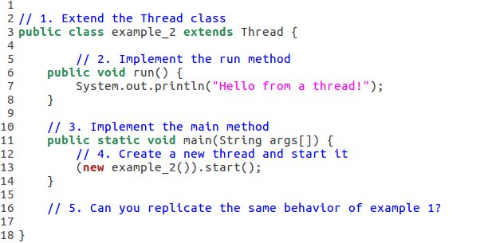
Thread objects (Creation)
Implementation by Extending Thread class
Notes:
Thread.sleep causes the current thread to suspend execution for a specified period

Slide 7
Thread objects (Creation)
Think:
Replicate the behavior of example_1 on example_2, does your program run in parallel?
Use run instead of start, what happens? Why?
What will happen when the main thread terminates?
Notes:
The printing is different, yeah sure it can replicate
Run is just a called function so it will not run in parallel.
As long as the main-method thread or any other user thread remains alive, your application will continue to execute.

Slide 8
Thread Objects (Interrupts)
What’s an thread interrupt?
To interrupt a thread call interrupt on the object
To check if the current thread is interrupted use: Thread.currentThread().isInterrupted()
To handle the interrupt, let the receiving method throw a InterruptedException
Catch the exception and do the required handling
Exercise: example_3.java
Notes:
An interrupt is an “indication” to a thread that it should stop what it is doing and do something else. It's up to the programmer to decide exactly how a thread responds to an interrupt, but it is very common for the thread to terminate.
Interruption is a cooperative mechanism. When one thread interrupts another, the interrupted thread does not necessarily stop what it is doing immediately. Instead, interruption is a way of politely asking another thread to stop what it is doing if it wants to, at its convenience. http://www.ibm.com/developerworks/library/j-jtp05236/

Slide 9
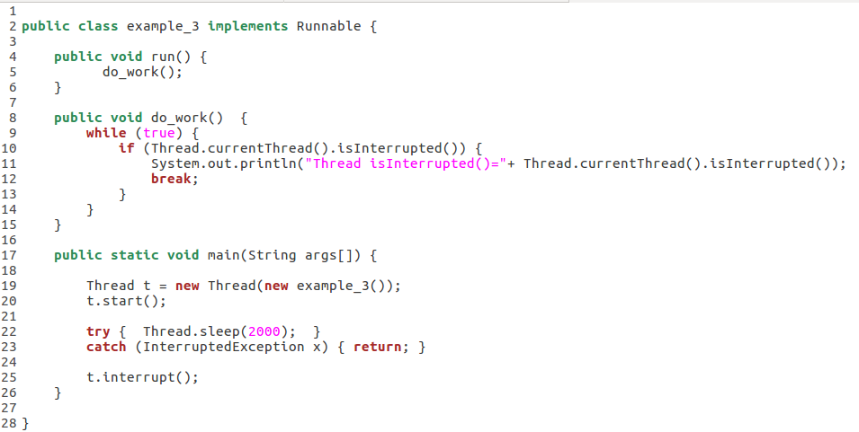
Thread Objects (Interrupts)
Notes:
An interrupt is an “indication” to a thread that it should stop what it is doing and do something else. It's up to the programmer to decide exactly how a thread responds to an interrupt, but it is very common for the thread to terminate.
Interruption is a cooperative mechanism. When one thread interrupts another, the interrupted thread does not necessarily stop what it is doing immediately. Instead, interruption is a way of politely asking another thread to stop what it is doing if it wants to, at its convenience. http://www.ibm.com/developerworks/library/j-jtp05236/

Slide 10
Thread Objects (Interrupts)
1. Send interrupt to the thread
Notes:
An interrupt is an “indication” to a thread that it should stop what it is doing and do something else. It's up to the programmer to decide exactly how a thread responds to an interrupt, but it is very common for the thread to terminate.
Interruption is a cooperative mechanism. When one thread interrupts another, the interrupted thread does not necessarily stop what it is doing immediately. Instead, interruption is a way of politely asking another thread to stop what it is doing if it wants to, at its convenience. http://www.ibm.com/developerworks/library/j-jtp05236/

Slide 11
Thread Objects (Interrupts)
2. Check if the thread received interrupt or not
Notes:
An interrupt is an “indication” to a thread that it should stop what it is doing and do something else. It's up to the programmer to decide exactly how a thread responds to an interrupt, but it is very common for the thread to terminate.
Interruption is a cooperative mechanism. When one thread interrupts another, the interrupted thread does not necessarily stop what it is doing immediately. Instead, interruption is a way of politely asking another thread to stop what it is doing if it wants to, at its convenience. http://www.ibm.com/developerworks/library/j-jtp05236/

Slide 12
Thread Objects (Interrupts)
A sleeping thread throws InterruptedException when interrupted
Notes:
An interrupt is an “indication” to a thread that it should stop what it is doing and do something else. It's up to the programmer to decide exactly how a thread responds to an interrupt, but it is very common for the thread to terminate.
Interruption is a cooperative mechanism. When one thread interrupts another, the interrupted thread does not necessarily stop what it is doing immediately. Instead, interruption is a way of politely asking another thread to stop what it is doing if it wants to, at its convenience. http://www.ibm.com/developerworks/library/j-jtp05236/

Slide 13
Thread Objects (Join)
In example_1.java, both main thread and new thread were printing together, can we postpone the execution of the main until all threads finish?
The join method allows one thread to wait for the completion of another.
Exercise: example_4.java
Create 2 threads, set a name for each, and set a sleeping period for each based on the thread id
Start threads
Wait for them to join the main thread
Check example_5.java, it sets the priority of a thread to either normal(5) or max(10), and changes the core of the run() method to do different things based on the threads priority. Anything interesting?
Notes:
The priorities forces thread 2 (with higher priority) to run first

Slide 14
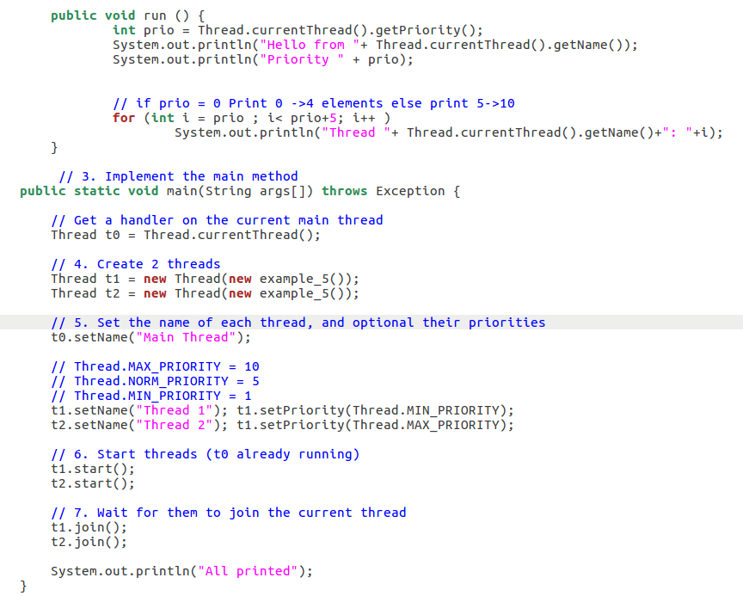
Notes:
The priorities forces thread 2 (with higher priority) to run first

Slide 15
Synchronization
Why we need synchronization (run example_6.java)?
Notes:
This relationship is simply a guarantee that memory writes by one specific statement are visible to another specific statement.

Slide 16
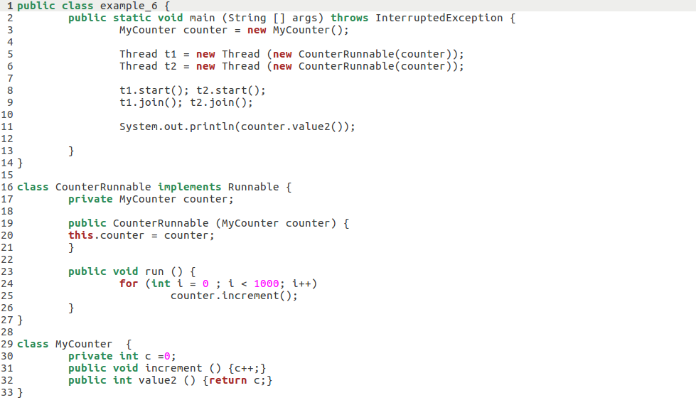
Synchronization
Why we need synchronization (example_6.java)?
The “happens before” relationship
Pros:
Maintaining memory consistency
Notes:
This relationship is simply a guarantee that memory writes by one specific statement are visible to another specific statement.

Slide 17
Synchronization
Why we need synchronization (example_6.java)?
The “happens before” relationship
Pros:
Maintaining memory consistency
Cons:
Thread contention
Synchronization using:
Locks
Intrinsic
Same Object, remember objects are sent by reference
Notes:
This relationship is simply a guarantee that memory writes by one specific statement are visible to another specific statement.

Slide 18
Synchronization
Why we need synchronization (example_6.java)?
The “happens before” relationship
Pros: Maintaining memory consistency
Cons: Thread contention
Synchronization using:
Locks
Intrinsic
Extrinsic
Atomic operations
Add synchronized to example_6.java (Is that what we want? )
Notes:
This relationship is simply a guarantee that memory writes by one specific statement are visible to another specific statement.

Slide 19
Intrinsic Locks
Implements the monitor construct to enforce mutual exclusion (mutex+condition)
An object has an associated intrinsic lock
A thread needs to acquire the lock before accessing this object’s fields, and releases it when done (happens before relation is established)
All other threads accessing this object block when the lock is not available (held by another thread)
Lock is released on return from the synchronized block, even if it was caused by an exception
What about static synchronized methods?
Notes:
Every object has an intrinsic lock associated with it. By convention, a thread that needs exclusive and consistent access to an object's fields has to acquire the object's intrinsic lock before accessing them, and then release the intrinsic lock when it's done with them. A thread is said to own the intrinsic lock between the time it has acquired the lock and released the lock. As long as a thread owns an intrinsic lock, no other thread can acquire the same lock. The other thread will block when it attempts to acquire the lock.
When a thread releases an intrinsic lock, a happens-before relationship is established between that action and any subsequent acquisition of the same lock.
When a thread invokes a synchronized method, it automatically acquires the intrinsic lock for that method's object and releases it when the method returns. The lock release occurs even if the return was caused by an uncaught exception.
You might wonder what happens when a static synchronized method is invoked, since a static method is associated with a class, not an object. In this case, the thread acquires the intrinsic lock for the Class object associated with the class. Thus access to class's static fields is controlled by a lock that's distinct from the lock for any instance of the class.

Slide 20
Synchronized keyword
Synchronized Methods:
Adding the keyword synchronized to a method synchronizes access to the object containing this method:
Prevents threads from interleaving execution on this portion.
Establishes a happens before relation with any subsequent invocation of the same method.
Constructors cannot be synchronized (syntax error)
If an object is shared between threads, all reads/writes to this object should be synchronized (What about final? )
Example_7.java, synchronizing 2 methods.
Notes:
Final, can be read through non- synchronized methods as no one will change its value

Slide 21
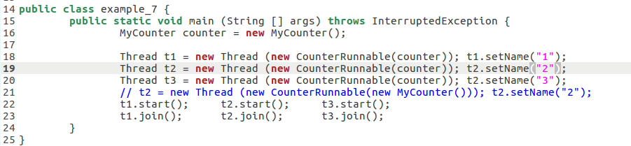
Synchronized keyword
Notes:
Final, can be read through non- synchronized methods as no one will change its value

Slide 22
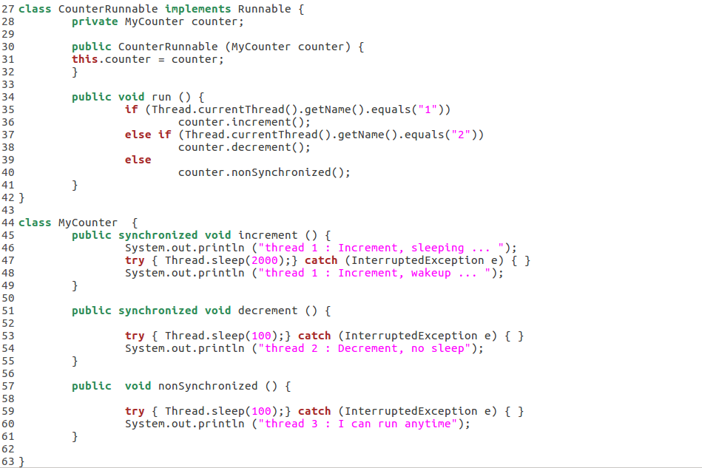
Synchronized keyword
Synchronized Function
Notes:
Final, can be read through non- synchronized methods as no one will change its value

Slide 23
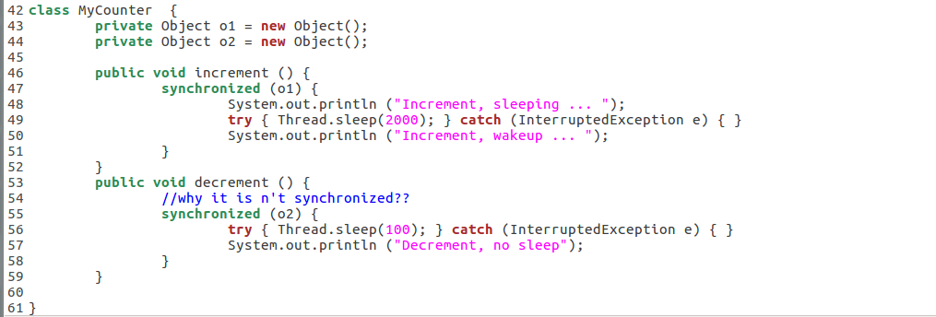
Synchronized keyword
Synchronized Statement
Notes:
Final, can be read through non- synchronized methods as no one will change its value

Slide 24
Synchronized keyword
Synchronization may lead to a deadlock : Example_9.java
Deadlock describes a situation where two or more threads are blocked forever, waiting for each other.
When a thread waits for a lock, but it’s used by another thread which also needs the lock of first thread so they are waiting for each other for ever

Slide 25
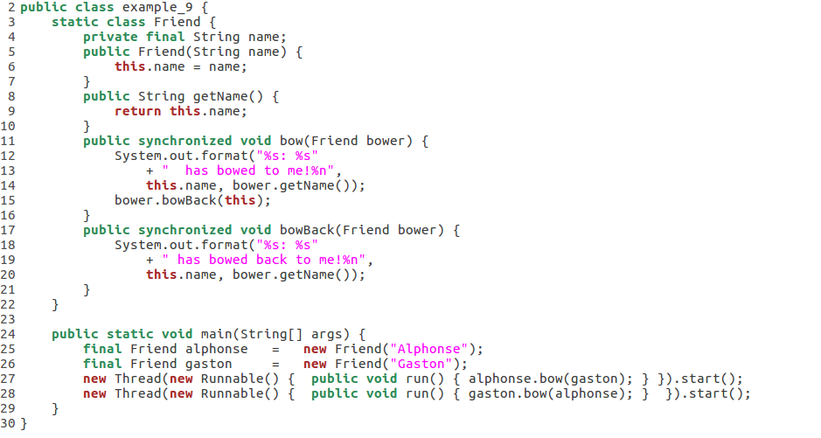
Synchronized keyword

Slide 26
Synchronized keyword
A
G
locked
locked
A.bow(G)
G.bow(A)
A.bowback()
G.bowback()

Slide 27
Synchronized keyword
A
G
locked
locked
A.bow(G)
G.bow(A)
A.bowback()
G.bowback()

Slide 28
Synchronized keyword
A
G
A.bow(G)
G.bow(A)
A.bowback()
G.bowback()
Want to acquire lock
Want to acquire lock

Slide 29
Synchronized keyword
A
G
A.bow(G)
G.bow(A)
A.bowback()
G.bowback()
Deadlock

Slide 30
Atomic Operations
All or none, why would that be needed?
Compare atomic to synchronized operations:
example_10.java
Notes:
Synchronized may slow down the thread execution, so if it’s about synchronizing the operation on supported atomic types, then use atomic to speedup the execution. Otherwise use synchronized

Slide 31
Guarded Blocks
Some threads may depend on others conditionally
To make a thread wait for a condition to be true use wait()
wait() only used with synchronized statement/functions
To let the other threads know that notifyAll()
Example_11.java
Notes:
Note: Always invoke wait inside a loop that tests for the condition being waited for. Don't assume that the interrupt was for the particular condition you were waiting for, or that the condition is still true.
Like many methods that suspend execution, wait can throw InterruptedException.
Why is this synchronized? Suppose d is the object we're using to invoke wait. When a thread invokes d.wait, it must own the intrinsic lock for d — otherwise an error is thrown. Invoking wait inside a synchronized method is a simple way to acquire the intrinsic lock.
When wait is invoked, the thread releases the lock and suspends execution. At some future time, another thread will acquire the same lock and invoke Object.notifyAll, informing all threads waiting on that lock that something important has happened

Slide 32
Summary
Thread is implemented by Extending Thread Class or implementing Runnable Interface
run() vs start()
sleep() / interrupt()
wait() / notify()
join()
Synchronized Function vs Synchronized Object

